Slide 1
Clock synchronization
Distributed Systems Project
AA 2012-2013
Dario Brazzi, Pegoraro Francesco

Slide 2
Project description
Implement a clock synchronization primitive. Choose the strategy that you think best to synchronize the clock of a requesting machine against that of a reference (server) machine.

Slide 3
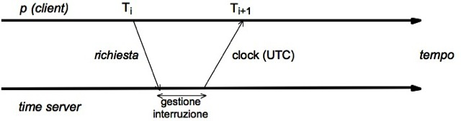
Cristian’s algorithm
Assumption: network traveling time in the two ways is comparable, possibly equal

Slide 4
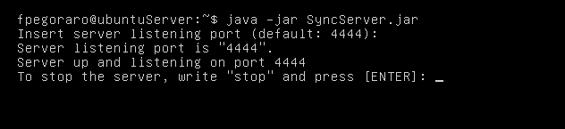
SyncServer
Can run on any java device
Responds to any proper request with the system’s clock
Can be configured the listening port (default: 4444)
Running on Ubuntu Server:

Slide 5
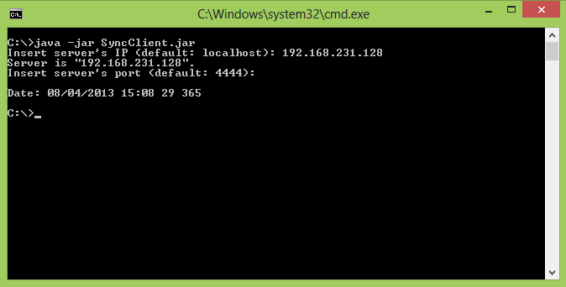
SyncClient
Can run on any java device
Need two paramenters:
Server IP or DNS Name (default: localhost)
Server Port (default: 4444)
Makes a single request to the server and displays the current time received from the server in human format
Running from a Windows cmd prompt:

Slide 6
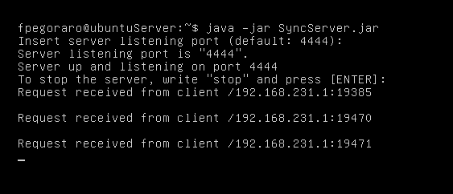
SyncServer
After receiving a requst from a client, updates the terminal with the information about the connected client

Slide 7
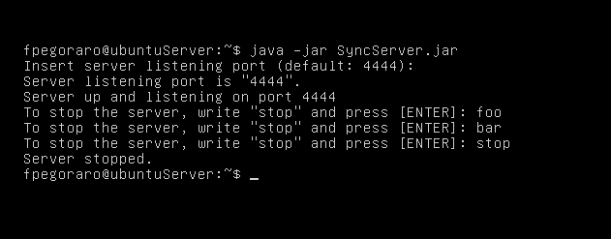
SyncServer
Sto stop a server, just type in «stop»
Any other command will be ignored

